Slide 1

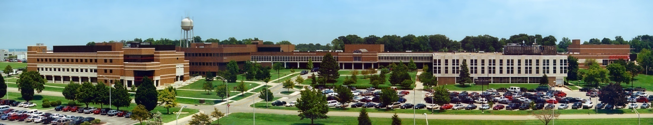
About Me
Air Force Institute of Technology
Douglas D. Hodson, PhD
Bldg 640, Rm 311C
255-3636 x4719

Slide 2
About Me
Short Bio
Bachelor's in Physics, Masters in Electro-Optics, MBA (finance, international finance, MIS), PhD Computer Engineering
Experience (knowledge) in the domain of Modeling and Simulation
Experience in computer programming (strong C++ orientation)
Teaching
Software engineering sequence (CSCE 693 / 793)
CSCE 693 : C++ focused
CSCE 793 : Special topics, usually heavily oriented and/or designed to support student thesis
CSCE 587 : Microprocessor Design and Synthesis

Slide 3
About Me
General interest areas
Modeling and Simulation
Realtime / highly interactive (human and/or hardware in the loop)
Non-realtime, so called constructive or analytic simulation
Common infrastructure concerns (e.g., software frameworks to support development of both kinds of applications)
Software architecture concerns
Game engine technologies that might be leveraged to support activities above
Thesis topics
AFRL’s Advanced Framework for Simulation, Integration and Modeling (AFSIM)
Open-source Mixed Reality Simulation Platform (MIXR)
UAS Data analytics
Game engine technologies as applied to DoD M&S domain

Slide 4
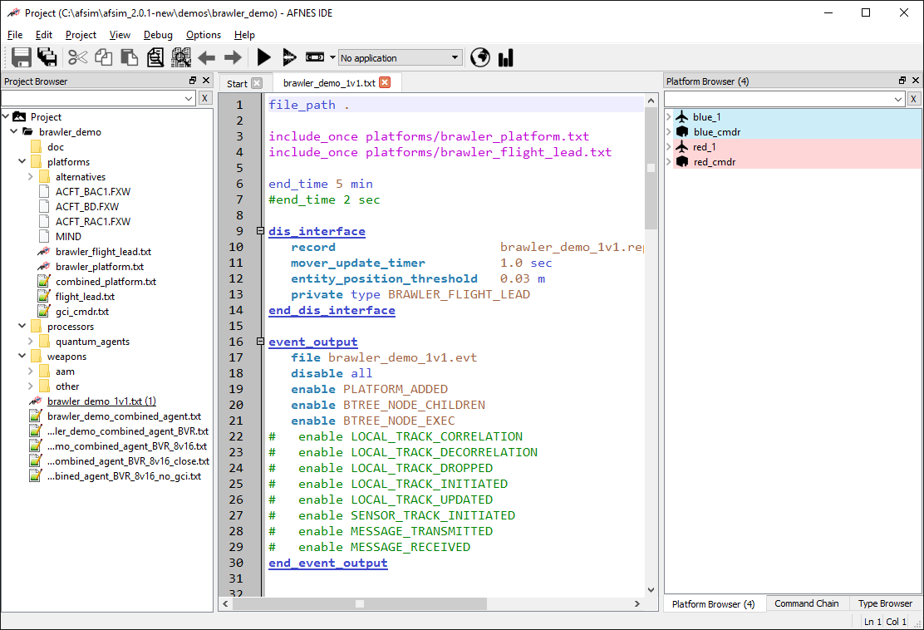
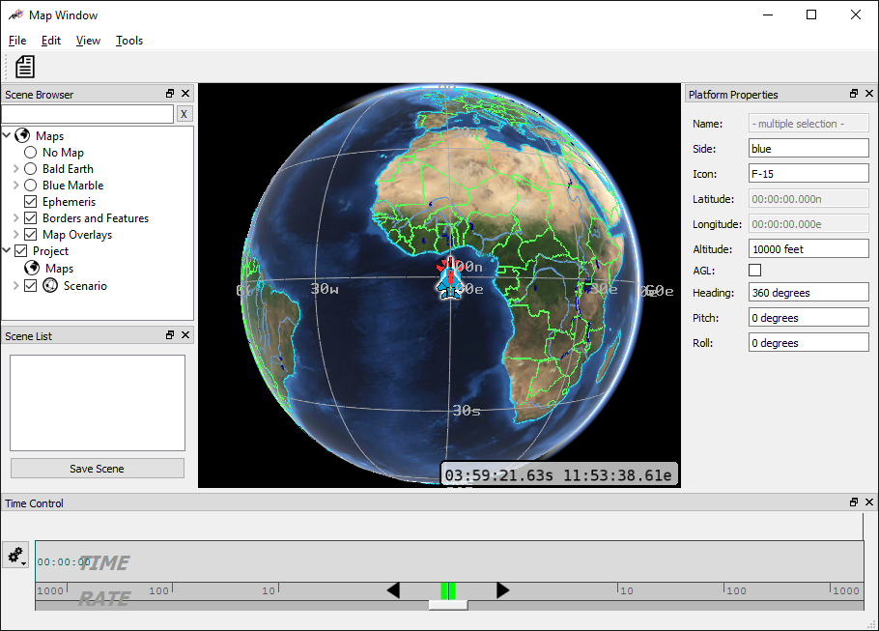
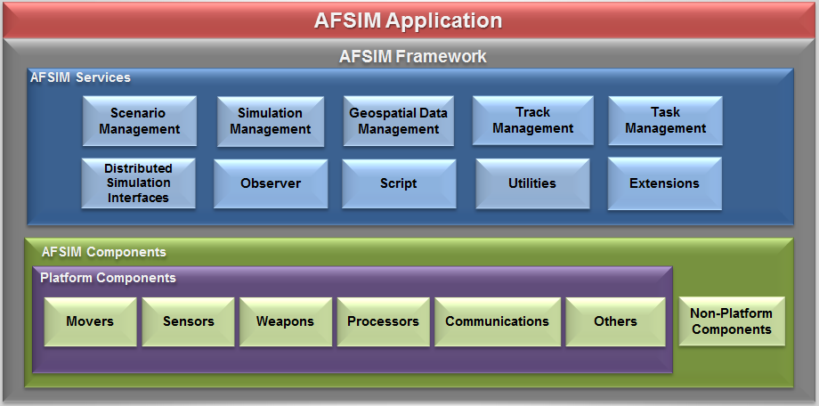
AFSIM
Topics
Extraction of Core Discrete Event “Engine”
Extraction of Script Language

Slide 5

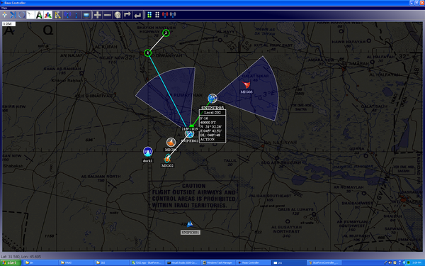
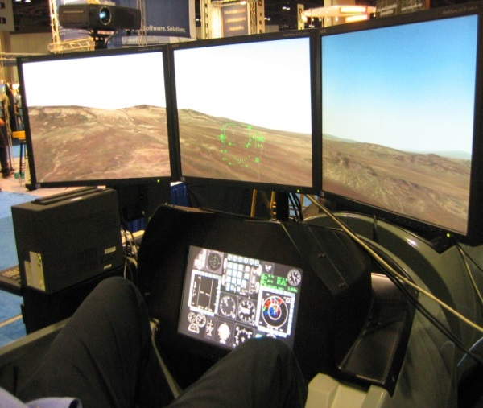
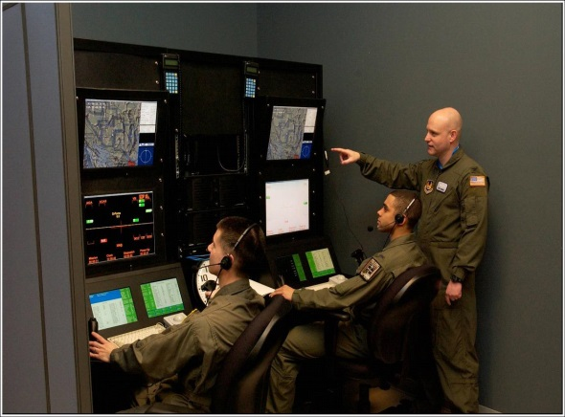
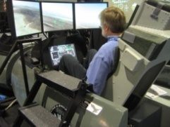
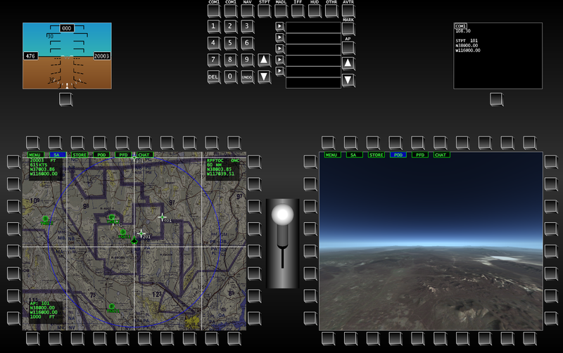
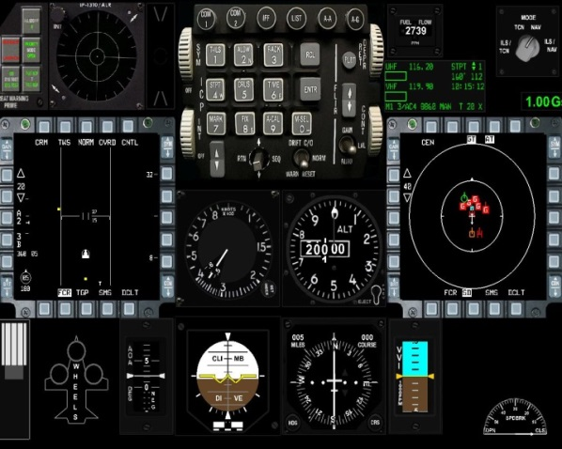
MIXR
Mixed Reality Environments / Virtual / Serious Gaming!

Slide 6
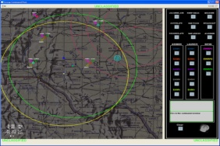
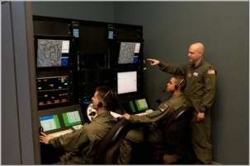
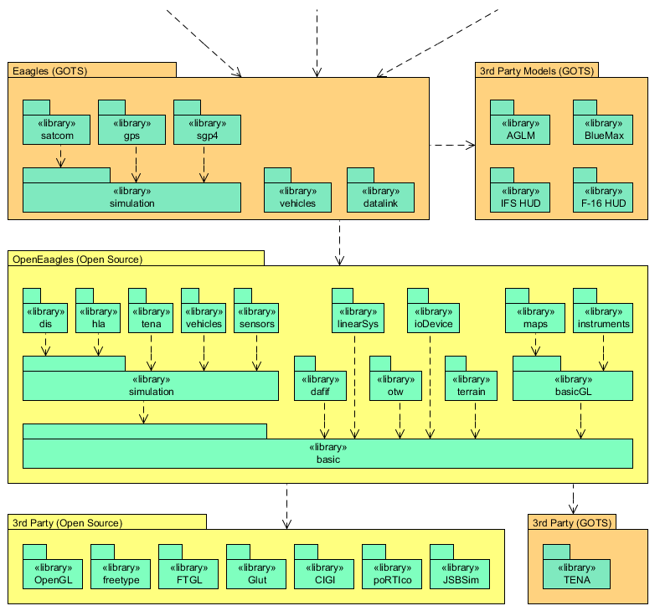
Simulation / Framework Relationship
Products
Simulators & Simulations Based on Framework Structure
Framework
Defines Simulation Architecture, PVI Graphics and Instruments Library, Input Language and Abstract Modeling Environments for RF, IR, datalinks, GPS, Satcom, Weapons, etc
External Packages to Support Graphics & Interoperability

Slide 7
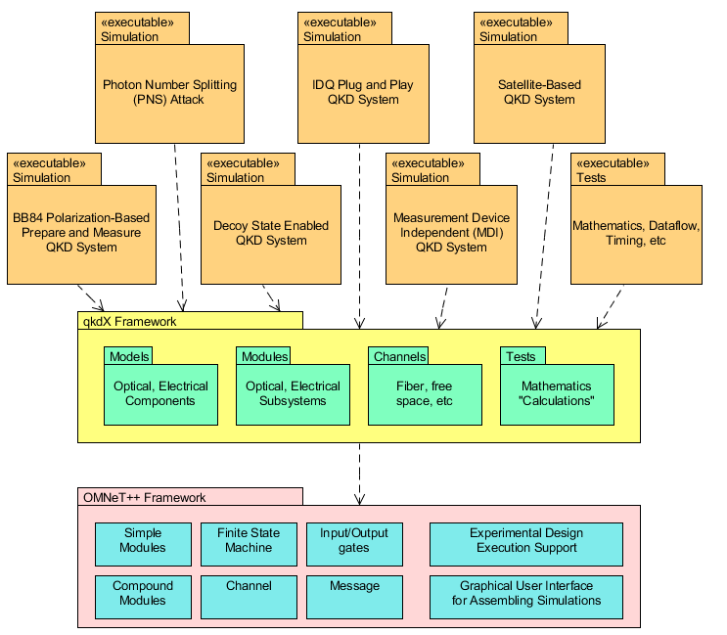
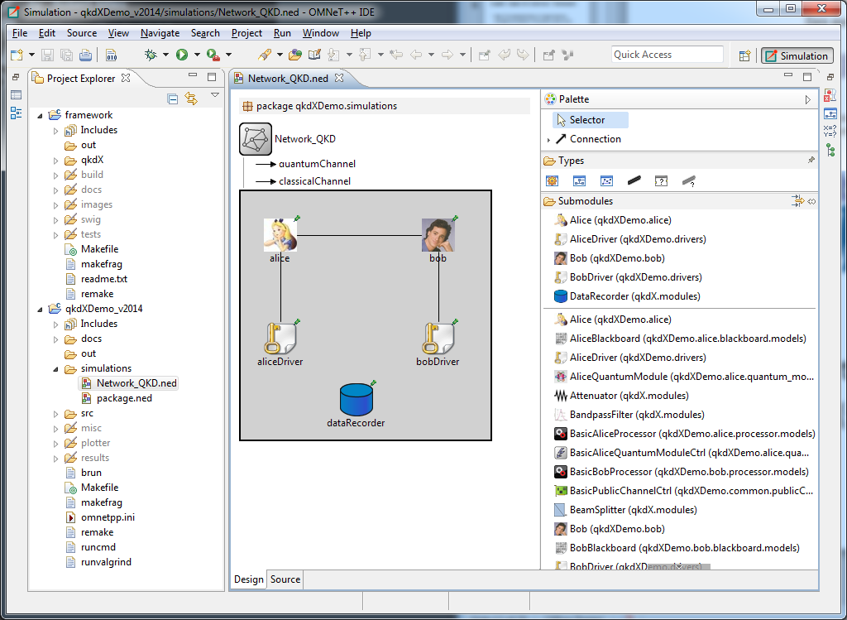
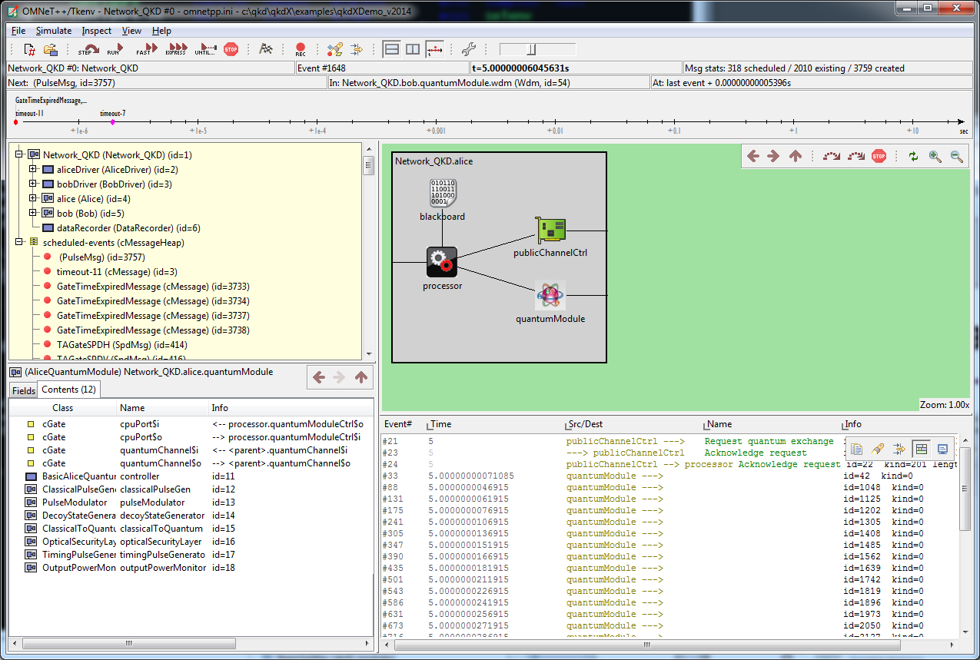
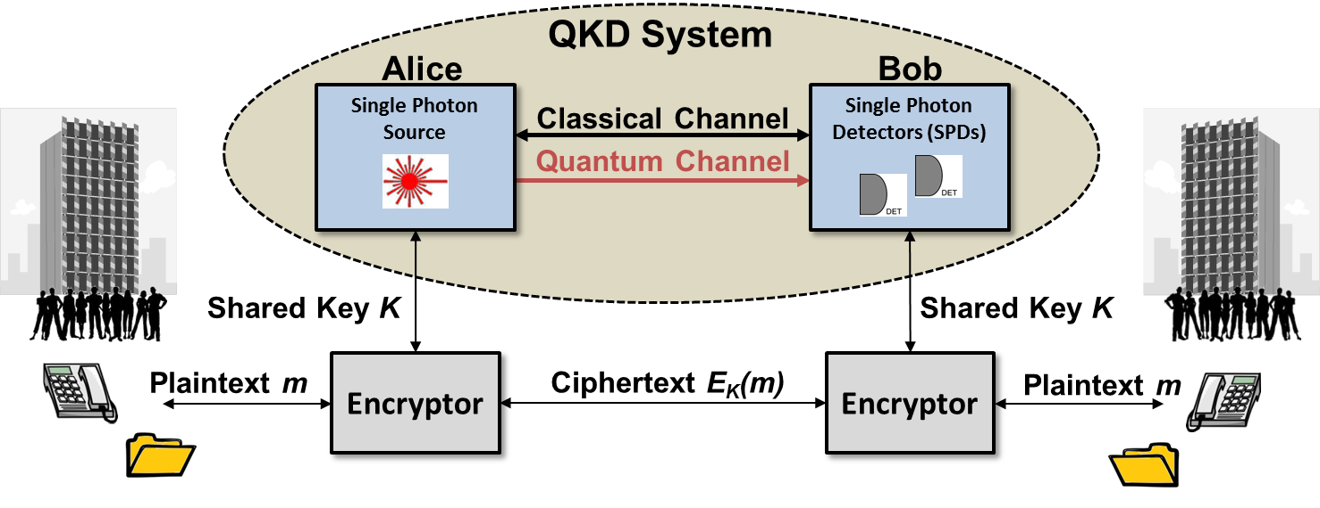
Modeling & Simulation Capability
Developed a hybrid Discrete Event Simulation (DES) / Continuous Time (CT) simulation framework to support the modeling and simulation of components used to build QKD systems

Slide 8
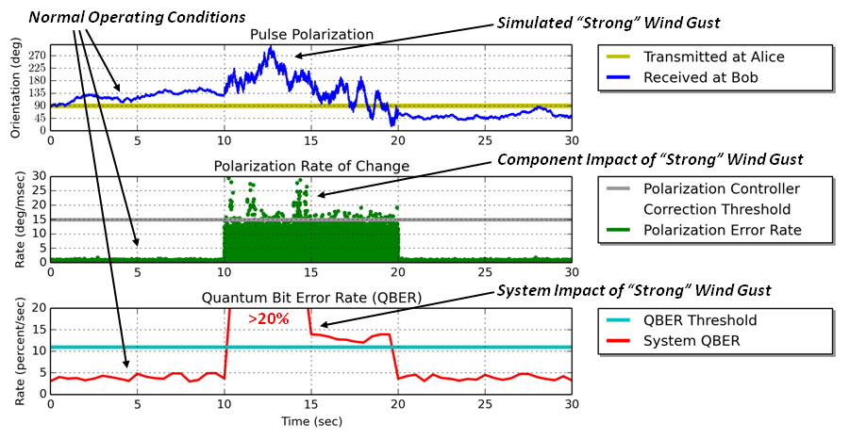
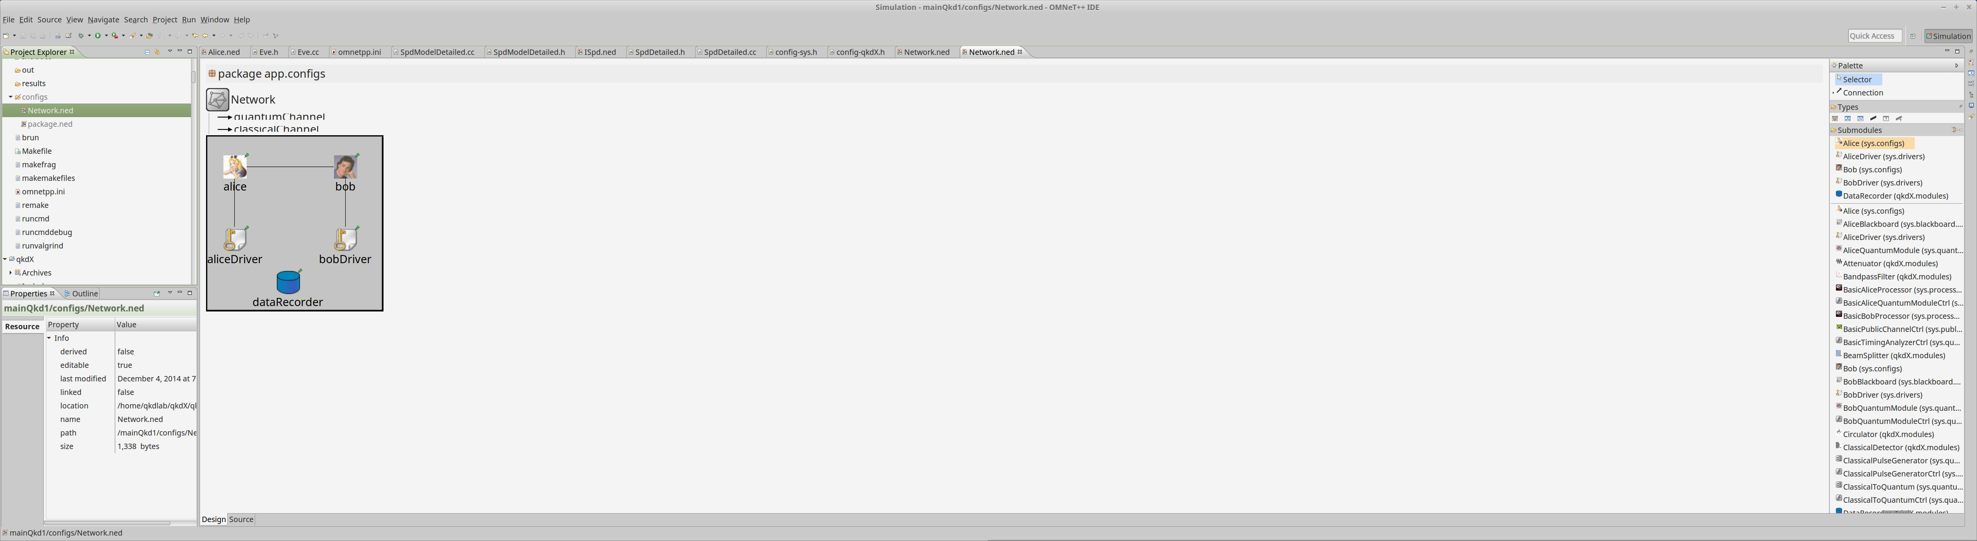
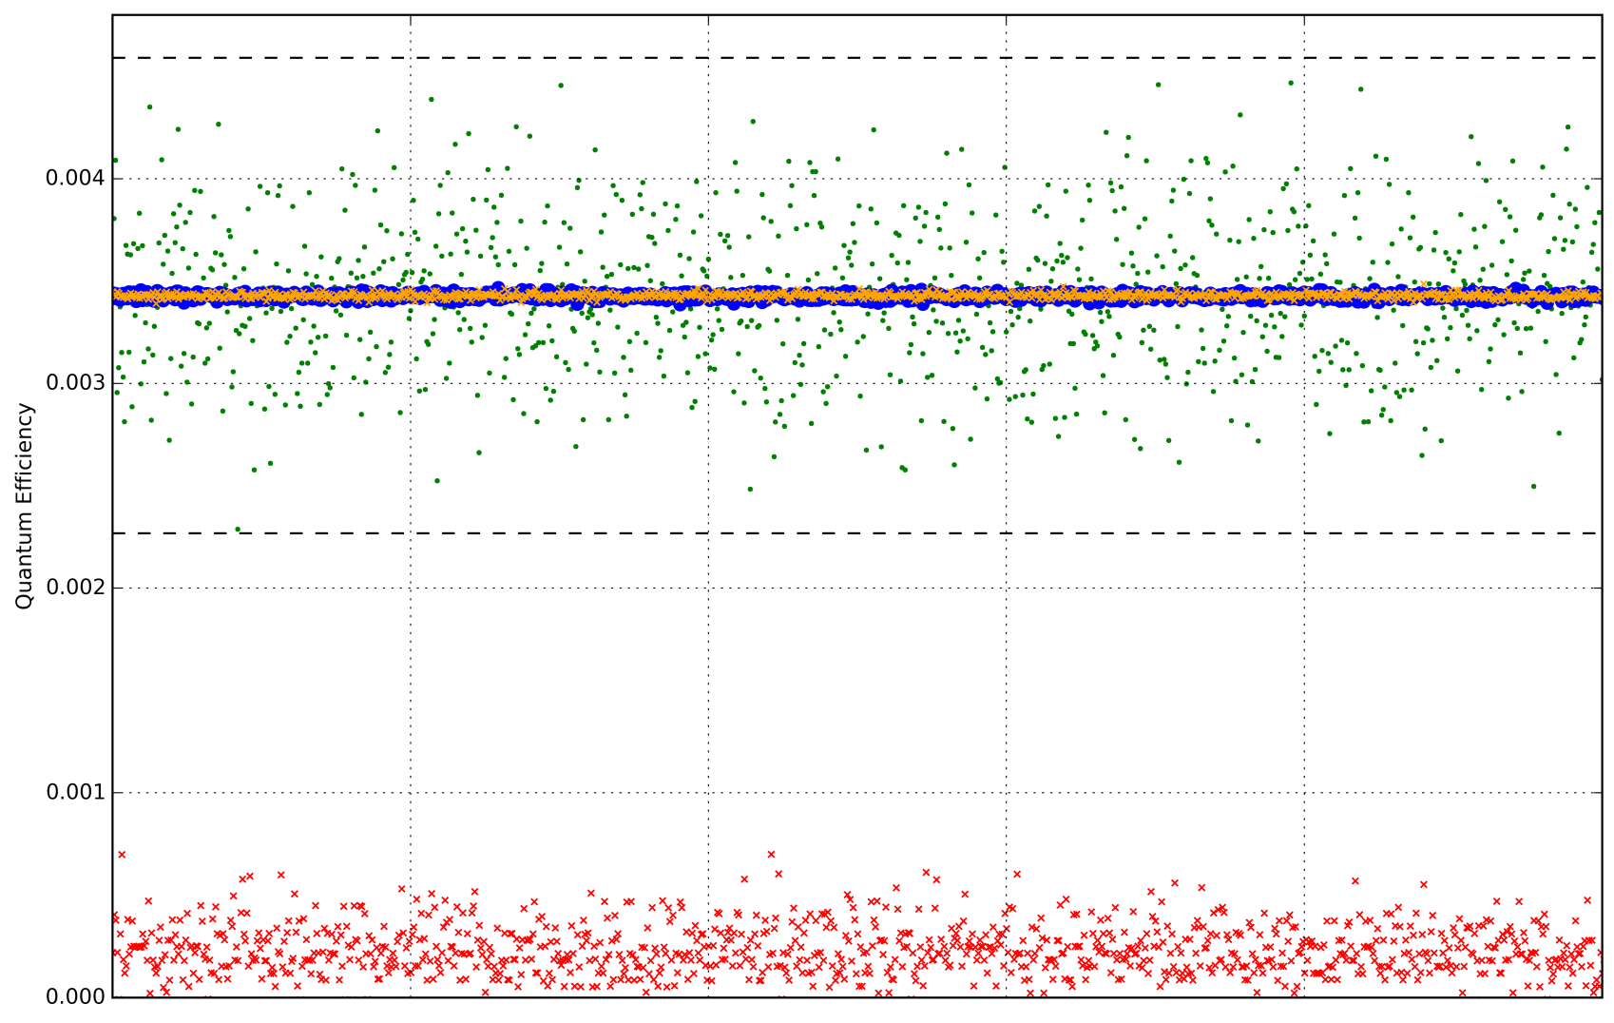
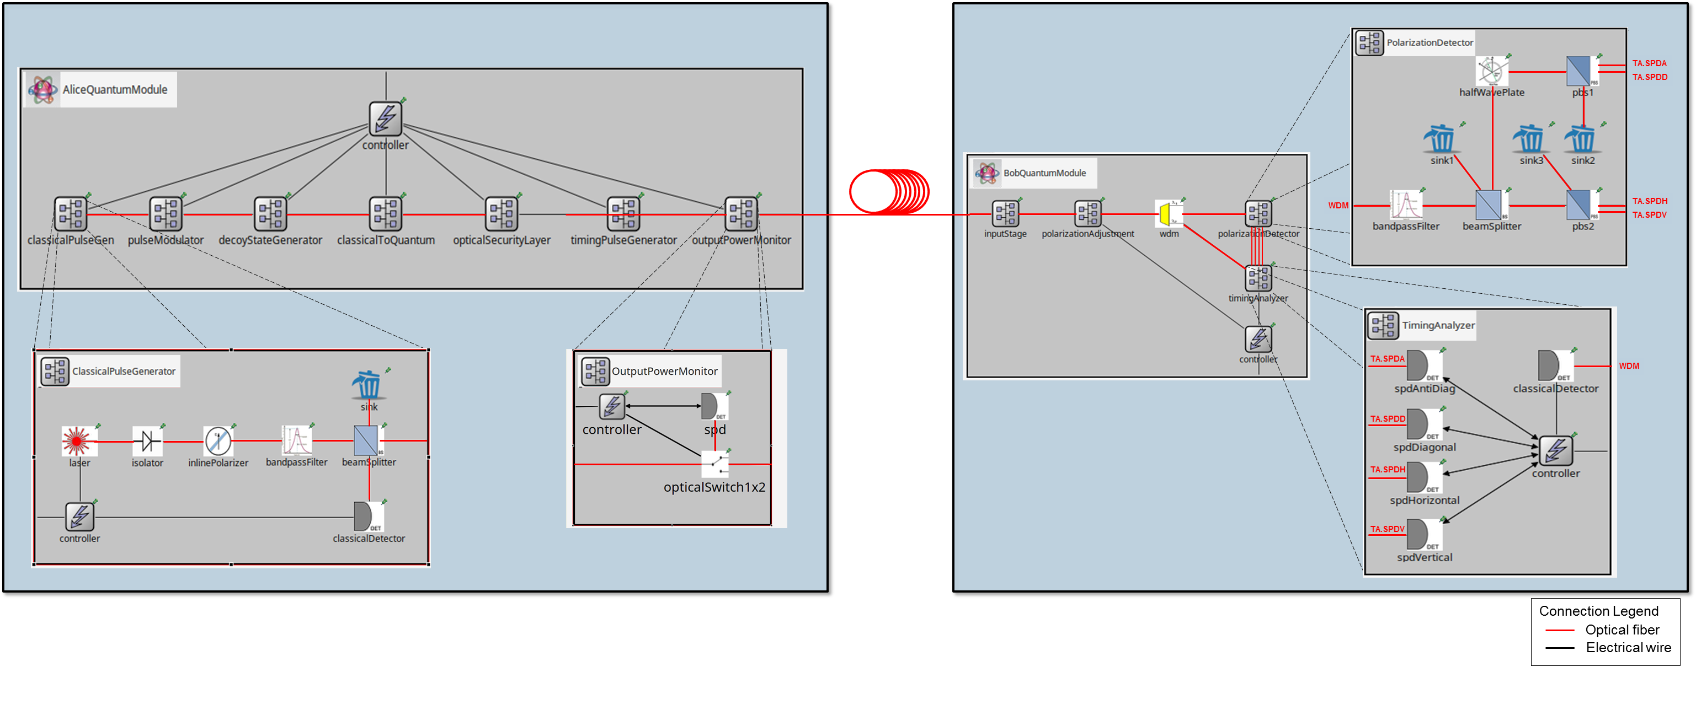
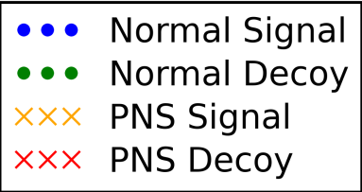
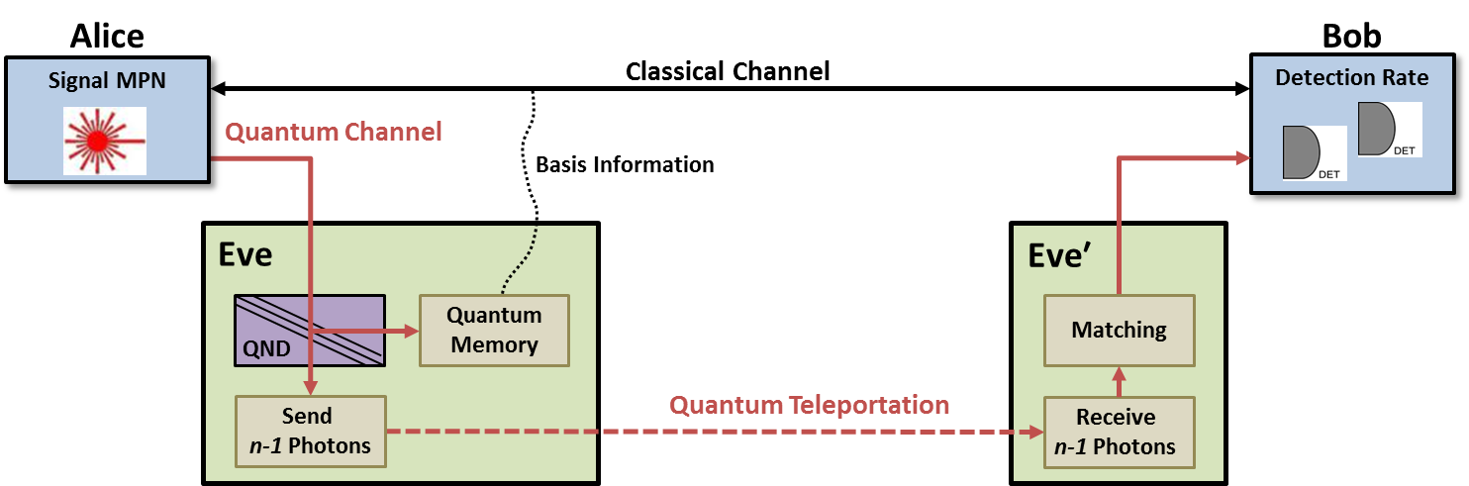
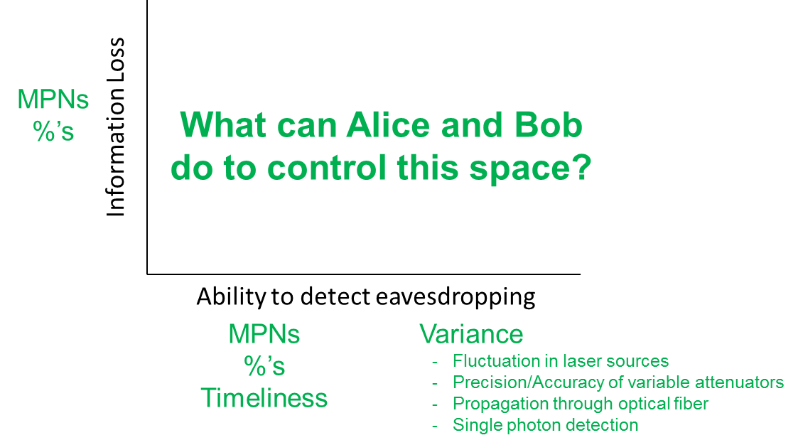
QKD System Non-ideality Studies
Physical disturbances in aerial fiber (2010 Toshiba Network)
Practically-oriented decoy state QKD systems (fastest & largest networks)
Photon Number Splitting (PNS) attacks (theoretical and practical variations)
99.9% Prediction Interval
99.9% Prediction Interval
1,000 Simulation Trials

Slide 9
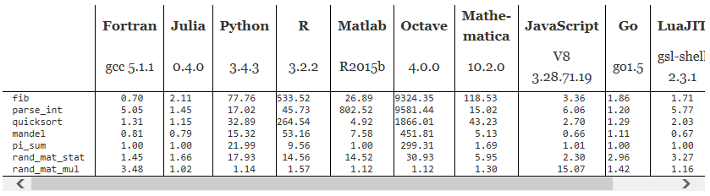


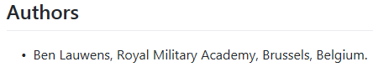
Topic of Interest
Topic
Implement quantum optics models defined in QKD framework in Julia and SimJulia

Slide 10
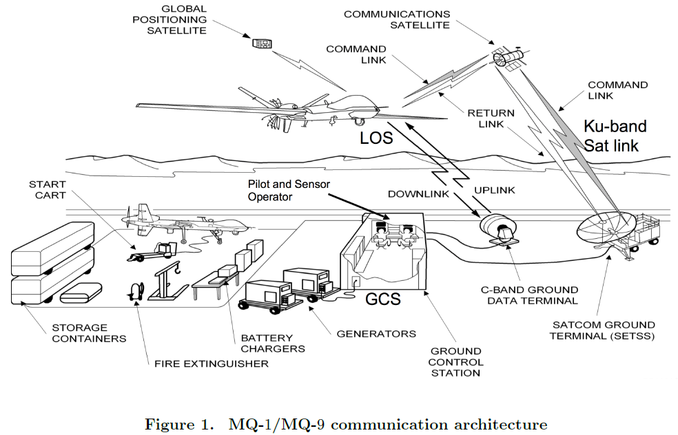
UAS System

Slide 11
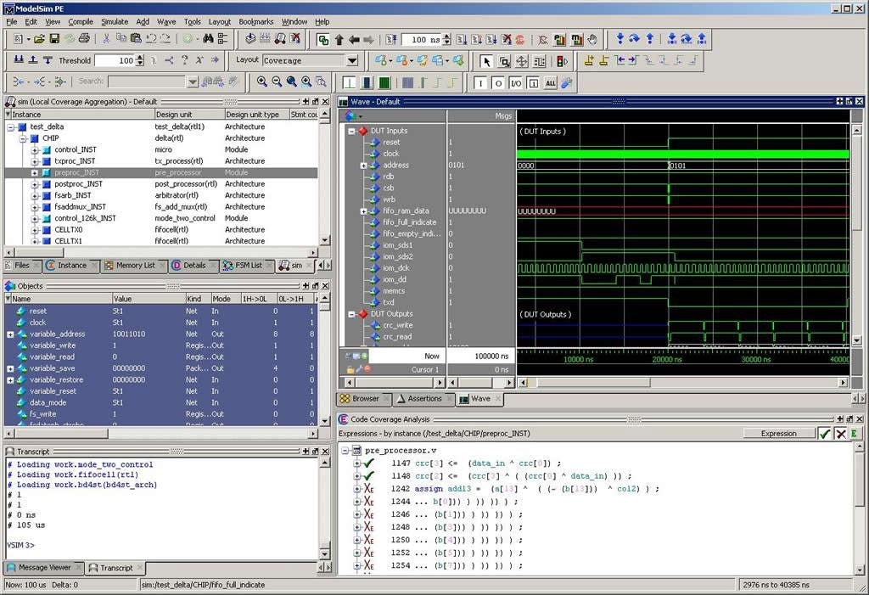

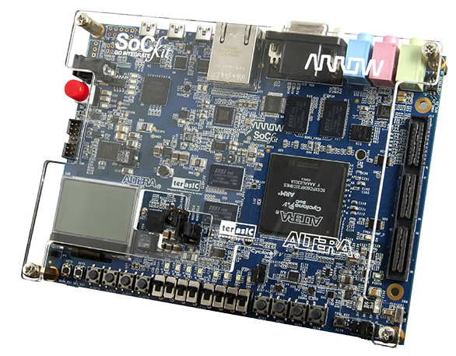

Simulation and Real Hardware
Modeling and Simulation Tool

Slide 12

CSCE 587 Book

Slide 13
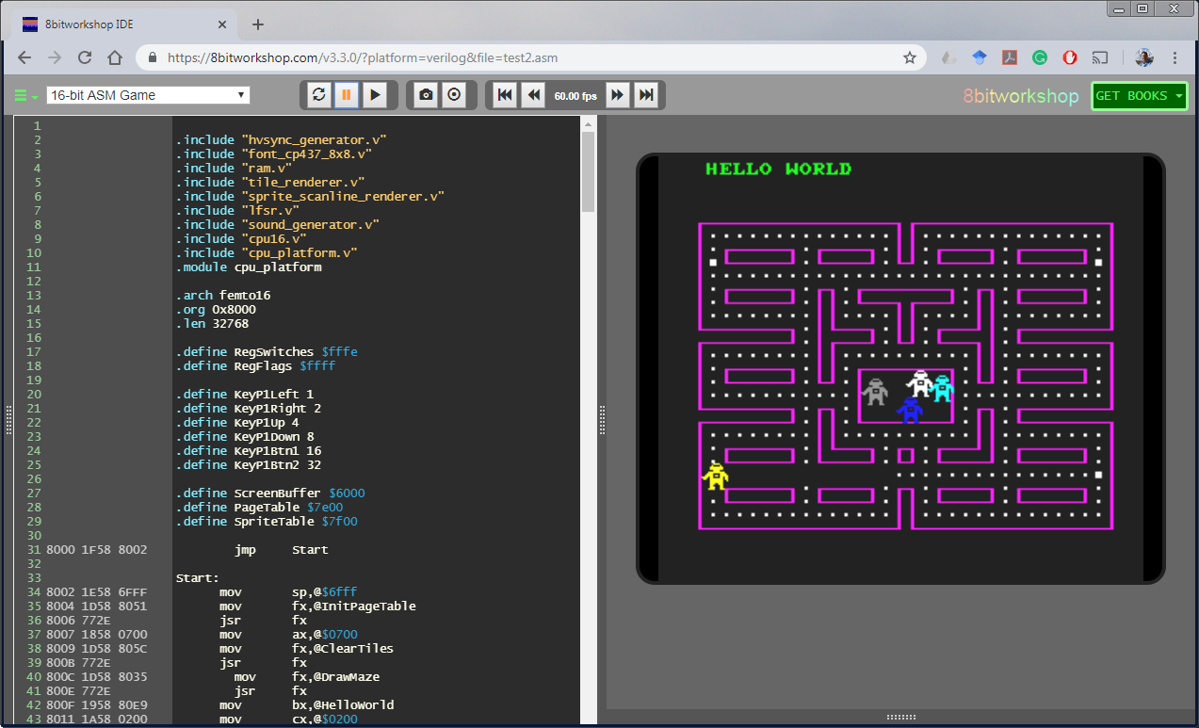
Online Simulator for CSCE 587

